Slide 1
Cardio Care Predictive Modeling for Heart Disease Diagnosis Using Machine Learning
Presented by:
Syed Muzzamil Waseem (11067)
Ahmer Hussain (10735)

Slide 2
Introduction
Health is characterized as a full state of physical, mental, and social well-being and not merely a lack of illness.
Health is a fundamental element of people’s need for a better life.
Unfortunately, the global health problem has created a dilemma because of certain factors, such as poor health services, the presence of large gaps between rural and urban areas, physicians, and nurses unavailability during the hardest time.

Slide 3
Dataset analysis
Cleveland Dataset:
Contains 11 features set Table with one binary target variable whether to classify patients have CVDs or not.
Contain 4 numerical features (age, resting bp, cholesterol, max heart rate) while the rest are categorical
Issues:
None of them found any null value but contained at least 17 outliers on some feature sets.

Slide 4
Performance and Comparison between different Models
Models | Precision | Recall | F1 Score | Accuracy
Logistic Regression | 0.86 | 0.87 | 0.86 | 0.86
SVM | 0.72 | 0.72 | 0.72 | 0.72
Decision Tree | 0.77 | 0.77 | 0.77 | 0.77
Random Forest | 0.85 | 0.86 | 0.86 | 0.86

Slide 5
Logistic Regression
Pros:
Interpretability: Logistic regression provides clear and interpretable results. The model's coefficients can be easily understood in terms of their impact on the odds of the outcome.
Efficiency: Logistic regression is computationally efficient and can handle large datasets without much computational burden. It's particularly useful when dealing with linearly separable data.
Cons:
Linearity Assumption: Logistic regression assumes a linear relationship between the features and the log-odds of the outcome. If the relationship is more complex, logistic regression might not perform well.
Sensitive to Outliers: Logistic regression can be sensitive to outliers, which might disproportionately influence the coefficients and predictions.

Slide 6
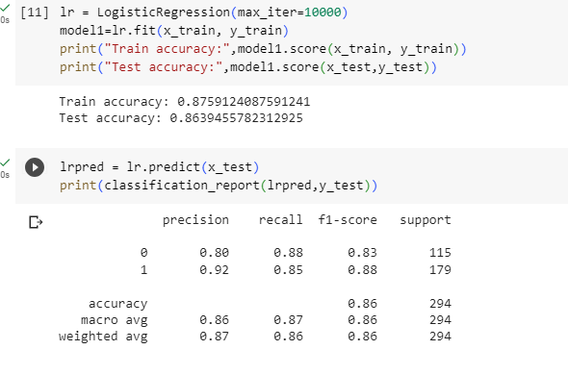
Code

Slide 7
Support Vector Machine
Pros:
Effective in High-Dimensional Spaces: SVM is highly effective in high-dimensional spaces, making it suitable for tasks involving many features or complex relationships.
Robust to Outliers: SVM aims to maximize the margin between classes, making it robust to outliers and less likely to overfit the data.
Cons:
Computational Complexity: Training an SVM can be computationally intensive, especially with large datasets. It may require substantial time and resources.
Sensitive to Noise: SVM's performance can be affected by noisy data or overlapping classes, requiring careful preprocessing and parameter tuning.

Slide 8
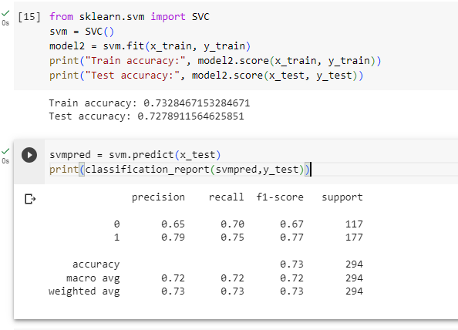
Code

Slide 9
Decision Tree
Pros:
Handle Non-linearity: Decision trees can capture complex non-linear relationships in the data, making them versatile for various types of problems.
Feature Importance: Decision trees can rank features based on their importance in making decisions, aiding feature selection and understanding the data.
Cons:
Overfitting: Deep decision trees can easily overfit the training data, capturing noise and leading to poor generalization on unseen data.
Instability: Small changes in the data can result in significant changes in the tree structure, making decision trees sensitive to variations in the training set.

Slide 10
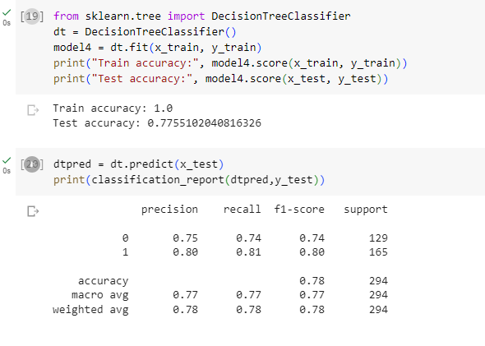
Code

Slide 11
Random Forest
Pros:
Feature Importance: Random Forest can provide insights into feature importance, helping to identify the most influential features for making predictions.
Robustness: Random Forest is robust to noisy data and outliers due to the ensemble nature that averages out individual decision tree errors.
Cons:
Complexity: Random Forest can be computationally intensive and memory-consuming, particularly with large datasets or a high number of trees.
Lack of Interpretability: Although it provides feature importance, Random Forest's ensemble nature can make it less interpretable than single decision trees.

Slide 12
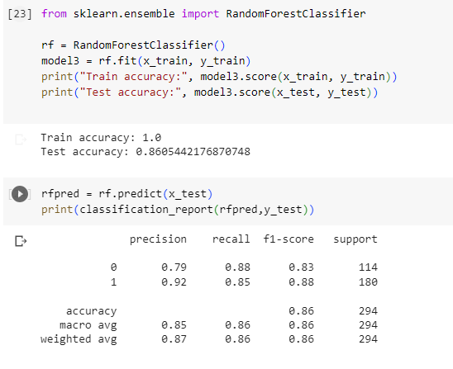
Code

Slide 13
Result
Logistic Regression (LR) and Random Forest (RF) appear to have the best performance, both achieving an accuracy score of 0.86. However, considering other factors such as the interpretability of the model, Logistic Regression might be preferred, as it often provides more intuitive insights into feature importance and relationships. Additionally, Logistic Regression generally has lower computational complexity compared to Random Forest, making it more efficient for certain applications.

Slide 14




Confusion Matrix
Logistic Regression SVM
Decision Tree Random Forest

Slide 15
Thank You

